Slide 1
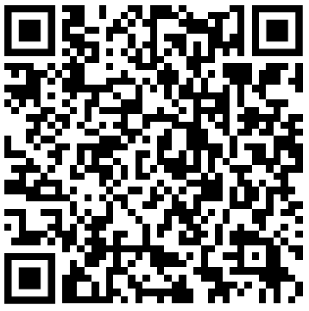
Current State of Artificial Intelligence
https://forms.gle/YG9TtSbimF2bhiUR8
Attendance
Code inside the form
We will start at 19:05

Slide 2
What is the “latest trend”
Attention
Vision Transformer
Paper: An Image is worth 16x16 words: Transformer for Image Recognition at Scale
Diffusion Model
Paper: Denoising Diffusion Probabilistic Model (DDPM)
Multi-Modality
Paper: Contrastive Language-Image Pretraining (CLIP) (OpenAI)

Slide 3
Recap on the various components of ML
X
f(X)
Input
ML Model f
Output
prediction
Update the weight
with Cost Function info
(gradient descent)
Compare by using
Cost/Loss Function
y
label
Objective: Minimise the loss
Or make Output Prediction as close to Label as possible

Slide 4
How data is changed by the model
Model function f with weights/parameters (θ, w, W). The weights are updated in training
Trainable weight
Input x_1
Output
f(x)
Input x_2
Altered Input

Slide 5
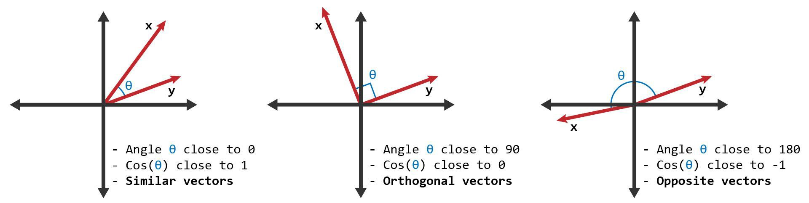
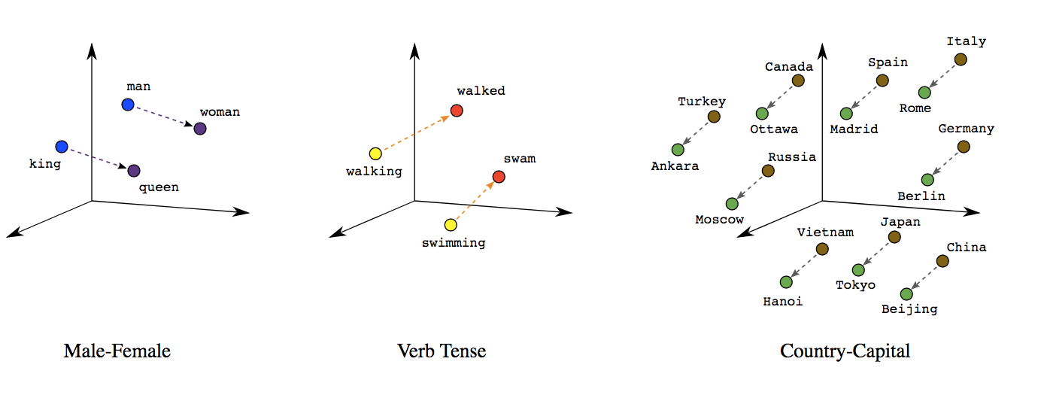
Cosine Similarity of vector data/embedding

Slide 6
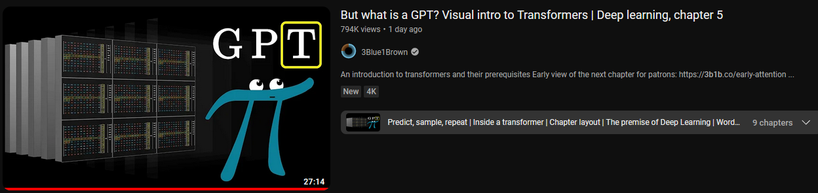
Recommended video
https://www.youtube.com/watch?v=wjZofJX0v4M

Slide 7
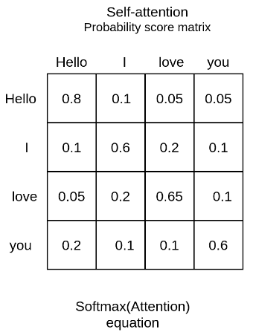
Attention mechanism (Self-attention)
Motivating question: We have a sequence of vectors, how do we make them aware of, attend to each other?
Text generation requires meaningful placement of words
We want an attention matrix
Hello
I
love
you
Analogy to Covariance matrix

Slide 8

Attention mechanism (Self attention)
https://www.youtube.com/watch?v=FC8PziPmxnQ
Hello
I
love
you

Slide 9
Attention mechanism (Self attention)
https://www.youtube.com/watch?v=FC8PziPmxnQ
Trainable weight
Q
query
Hello
I
love
you
K
key
V
value
Google search map your query with a key from database, and return the value

Slide 10
Attention mechanism (Self attention)
https://www.youtube.com/watch?v=FC8PziPmxnQ
Trainable weight
Altered Input
Q
query
Hello
I
love
you
K
key
V
value
Google search map your query with a key from database, and return the value

Slide 11

Attention mechanism (Self attention)
https://www.youtube.com/watch?v=FC8PziPmxnQ
Trainable weight
Altered Input
Q
query
Dimension sequence length x sequence length
Hello
I
love
you
Altered Input
K
key
V
value
Google search map your query with a key from database, and return the value

Slide 12
Attention mechanism (Self attention)
https://www.youtube.com/watch?v=FC8PziPmxnQ
Trainable weight
Altered Input
Q
query
Dimension sequence length x sequence length
Hello
I
love
you
K
key
V
value
Google search map your query with a key from database, and return the value

Slide 13
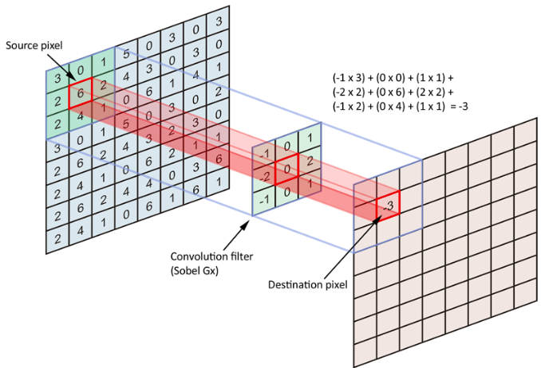
Vision-Transformer
Trainable weight
Why CNN?
We want to keep the spatial relationship between the data points in 2D
Why Attention mechanism
It checks the relationship between the series of data points
Breakdown 2D into 1D sequence
Altered Input

Slide 14
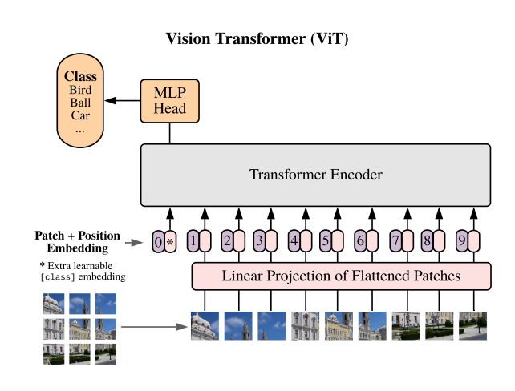
Vision-Transformer
Convert 2D image into 1D sequence
Treat each of these 16x16 patch like an embedding in the case of NLP

Slide 15
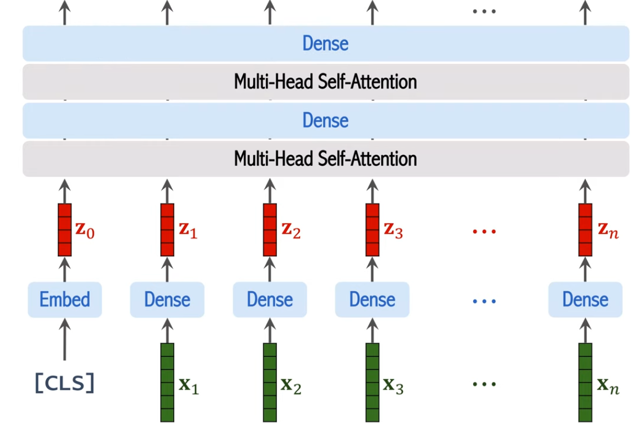
Vision-Transformer
Trainable weight
Multi-head attention score
Altered Input
Altered Input

Slide 16
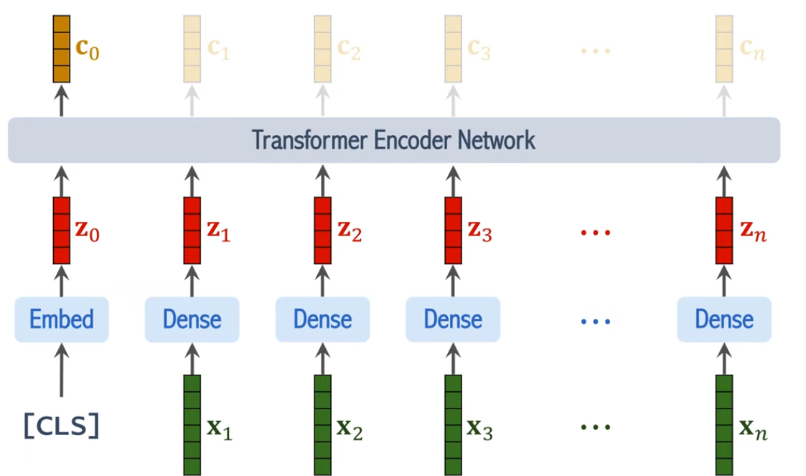

Vision-Transformer
Why do we discard these output?
If the forward pass doesn’t go there, it will not be involved in the back propagation
The weights will update accordingly to only use c0
based on
Back propagation

Slide 17
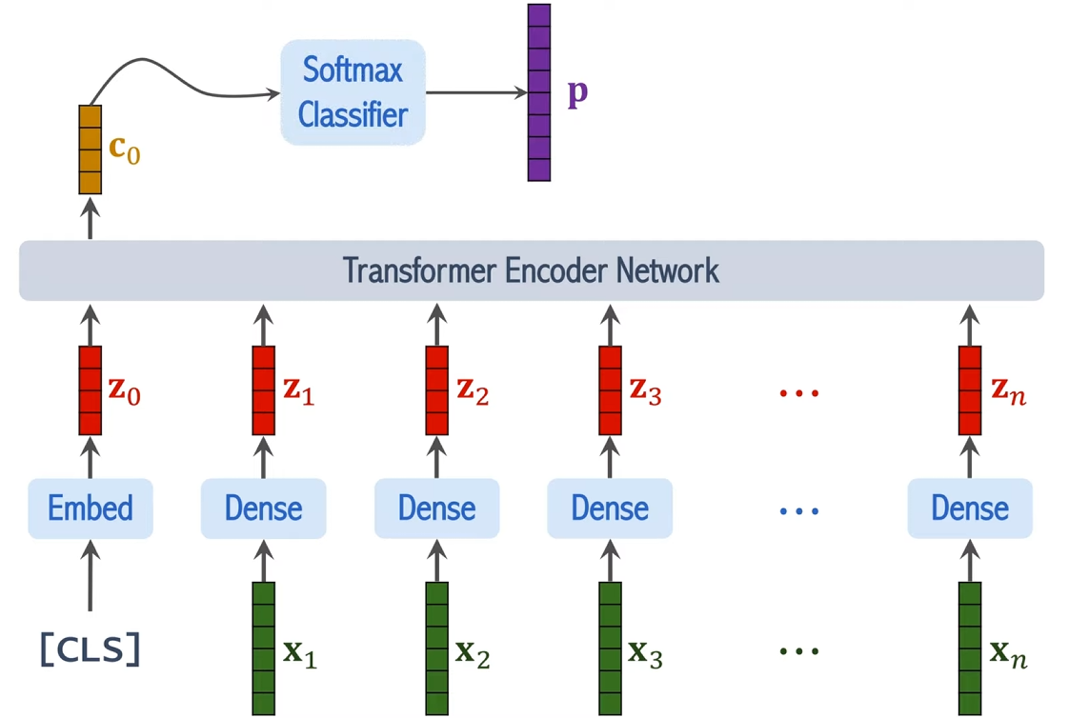
Vision-Transformer

Slide 18
Multi-Modality
Adding different data types, modalities
Image, text, audio, temporal-domain (time)
All of the data type is represented as vectors/matrices/tensors
Question: how to make use of all these data in the model?
Image
Video = Image with temporal domain
Image 0
…
Image n
Text
Embeddings
Tabulated
Scalar data

Slide 19
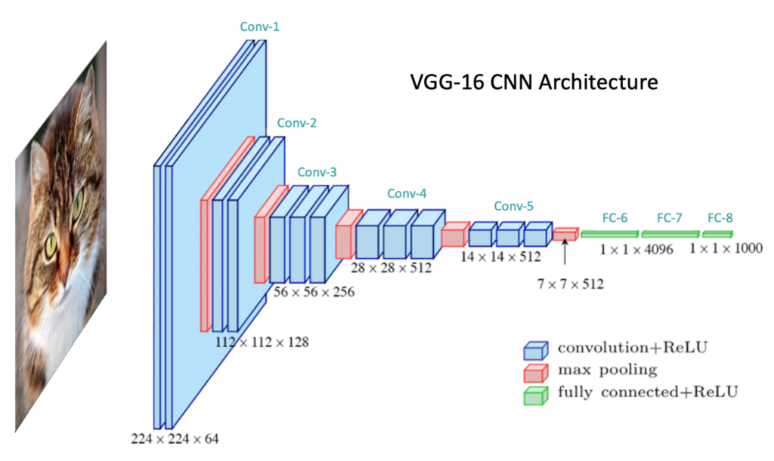
Fusion (simple, naive way)
Flatten
Different image channels, into 1D tensor
Then MLP from there
Concatenate
Concatenate the different modality
Image
Some model, CNN,...
Image
=
=
Tabulated
Scalar data
Tabulated
Scalar data
Processing

Slide 20
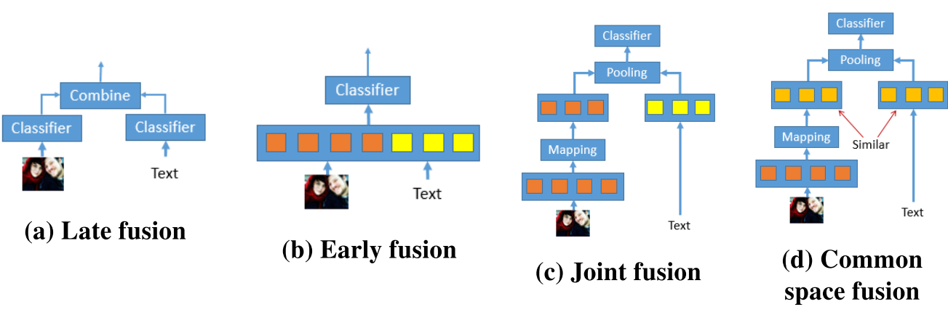
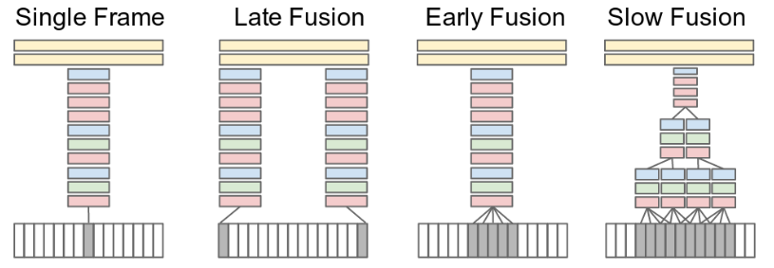
Different ways

Slide 21
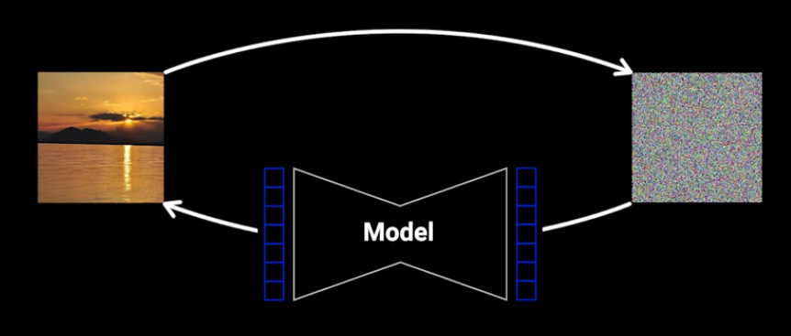
Diffusion Model
Reference: https://www.youtube.com/watch?v=HoKDTa5jHvg
Generate image from a noisy starting image

Slide 22
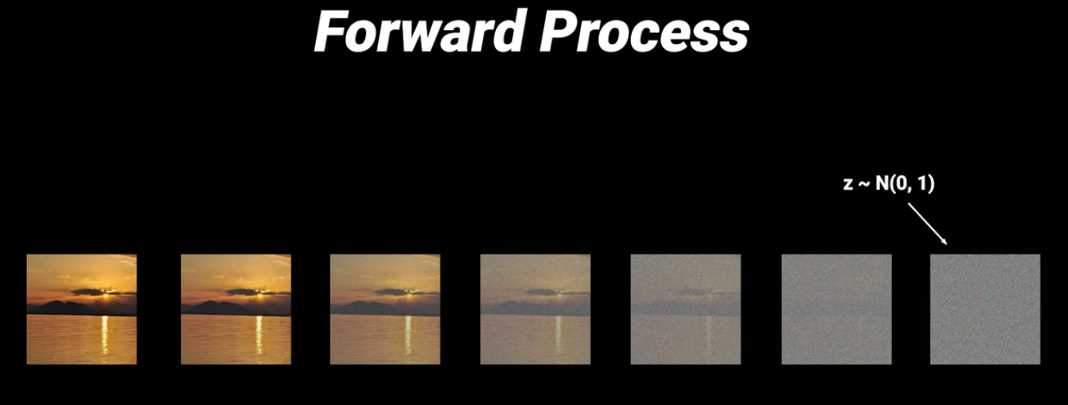
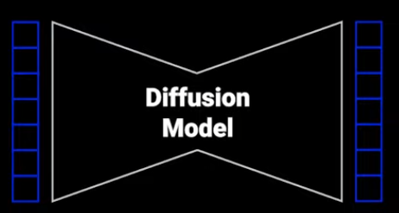
Diffusion Model
Reverse Process

Slide 23
Diffusion Model
When we add noise, we have the ground truth label for time steps
Each of the img is a label
output
input
output
input

Slide 24
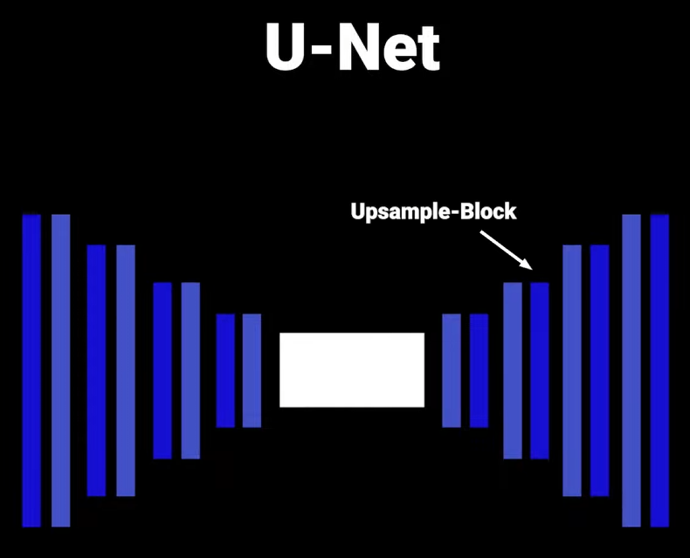
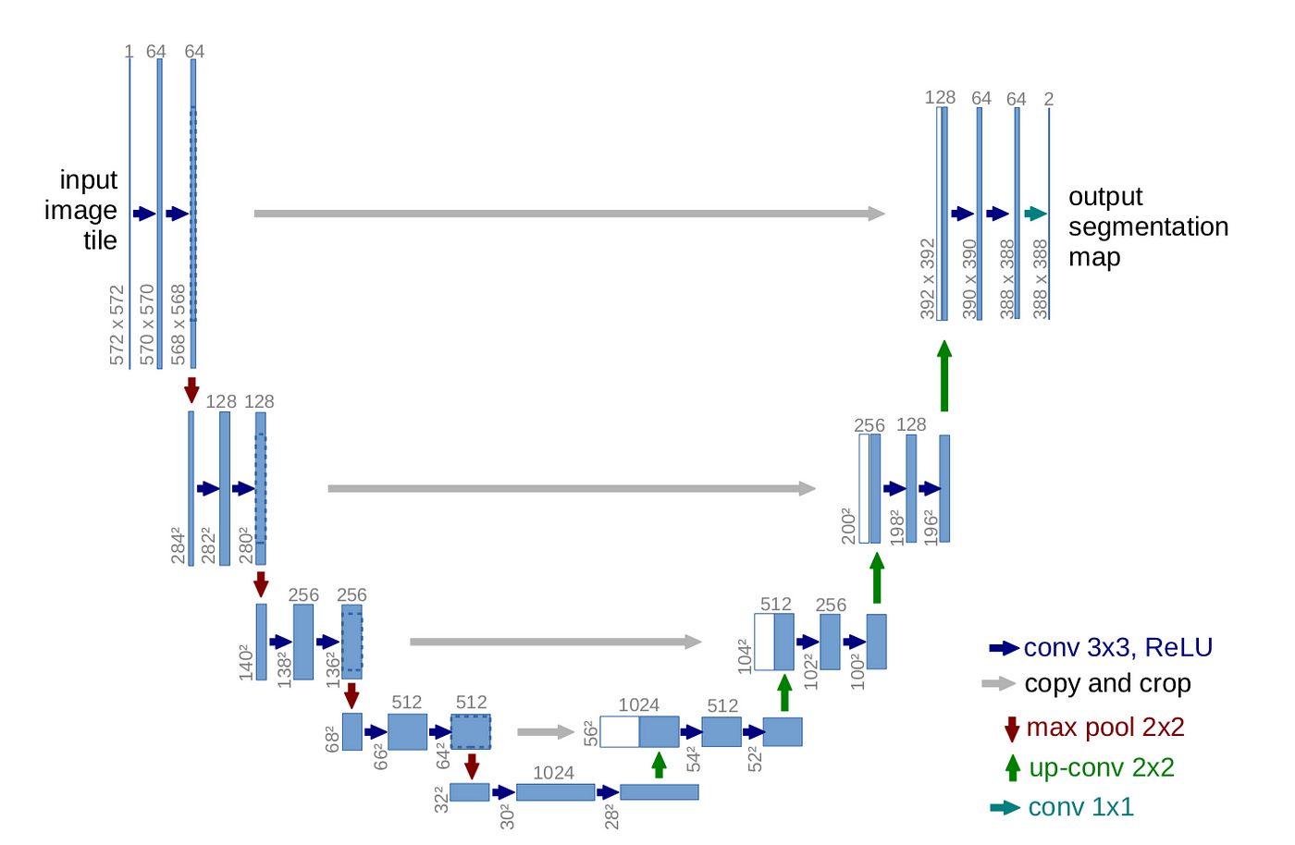
U-Net (CNN based)

Slide 25
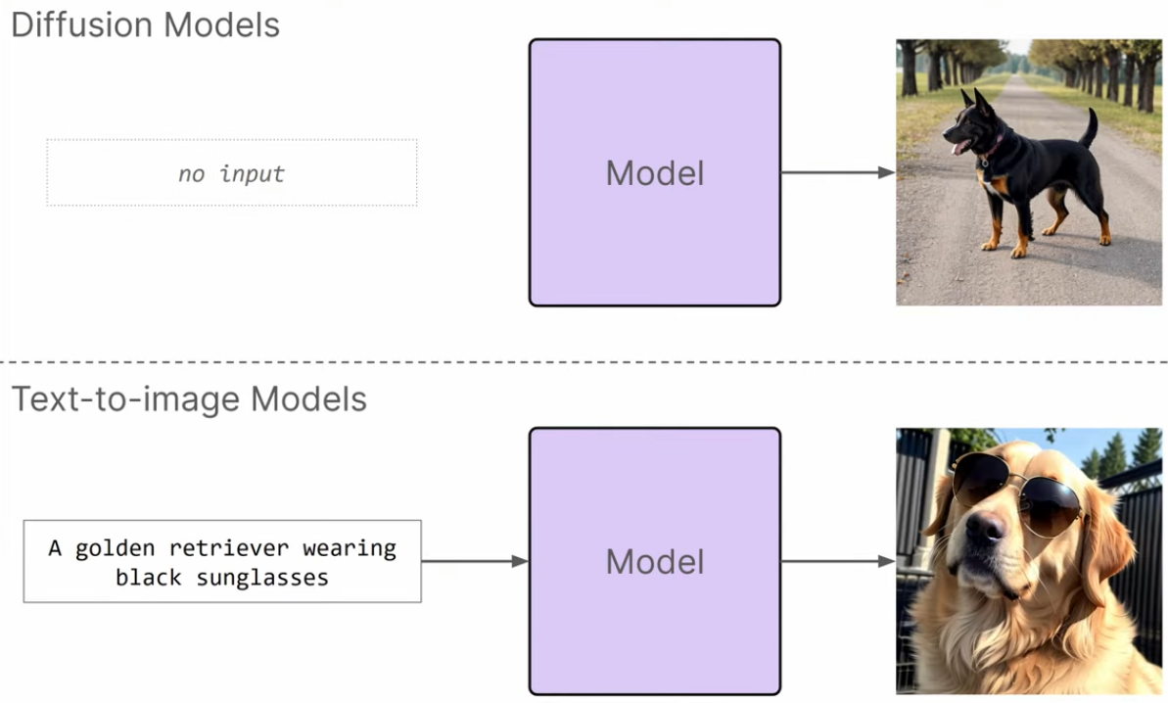

What is the output?
Random image generated
Guided by the text prompt

Slide 26
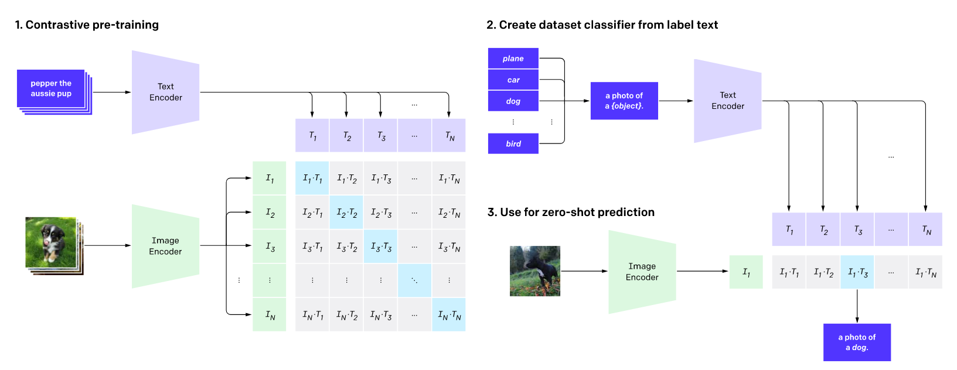
Contrastive Language-Image Pretrained (CLIP)
Image classification into a text similarity problem

Slide 27

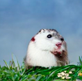
… many more in the dataset
Pepper the Aussie pup
Hamster
on grass

Slide 28
… many more in the dataset
Pepper the Aussie pup
Hamster
on grass
Trainable weight
Pepper the Aussie pup
Altered Input
Hamster
on grass
…
Altered Input: after cosine similarity
…
Trainable weight
Altered Input

Slide 29
… many more in the dataset
Pepper the Aussie pup
Hamster
on grass
Trainable weight
Pepper the Aussie pup
Altered Input
Hamster
on grass
…
Altered Input: after cosine similarity
1
0
0
Loss function
0
1
identity
…
1
0
0
0
1
Trainable weight
Label
Altered Input

Slide 30
Trained weight
Altered Input, the way the encoder is trained
Trained weight
Softmax for classification

Slide 31
Adding to our Diffusion model
Repeat until
“no noise”
input
output
input
output
Text Encoder
Prompt: sunset
Text Encoder
Prompt: sunset

Slide 32
Colab Link
Vision Transformer
https://colab.research.google.com/github/hirotomusiker/schwert_colab_data_storage/blob/master/notebook/Vision_Transformer_Tutorial.ipynb
Constrastive Language-Image Pretraining https://colab.research.google.com/github/openai/clip/blob/master/notebooks/Interacting_with_CLIP.ipynb

